Slide 1

Involving Alumni in Learner Focused Instruction: Problem Based Learning
Christina Bratlund, Terry D. Douglas, Karen Mainess, & Jennifer St. Clair
Faculty Development Showcase
Thursday, February 27, 2014

Slide 2
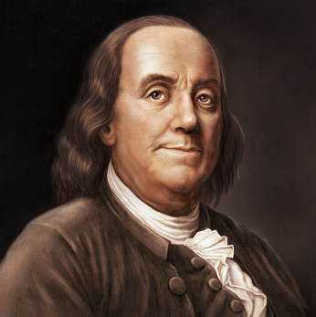
Sage Advice About Education. . .
Tell me and I forget, teach me and I may remember, involve me and I learn – Benjamin Franklin

Slide 3

In learning you will teach, and in teaching you will learn – Phil Collins

Slide 4

You will never learn as much as when you are teaching – Author Unknown

Slide 5

I am always ready to learn although I do not always like being taught –
Winston Churchill

Slide 6

Education is not the learning of facts, but the training of the mind to think –
Albert Einstein

Slide 7
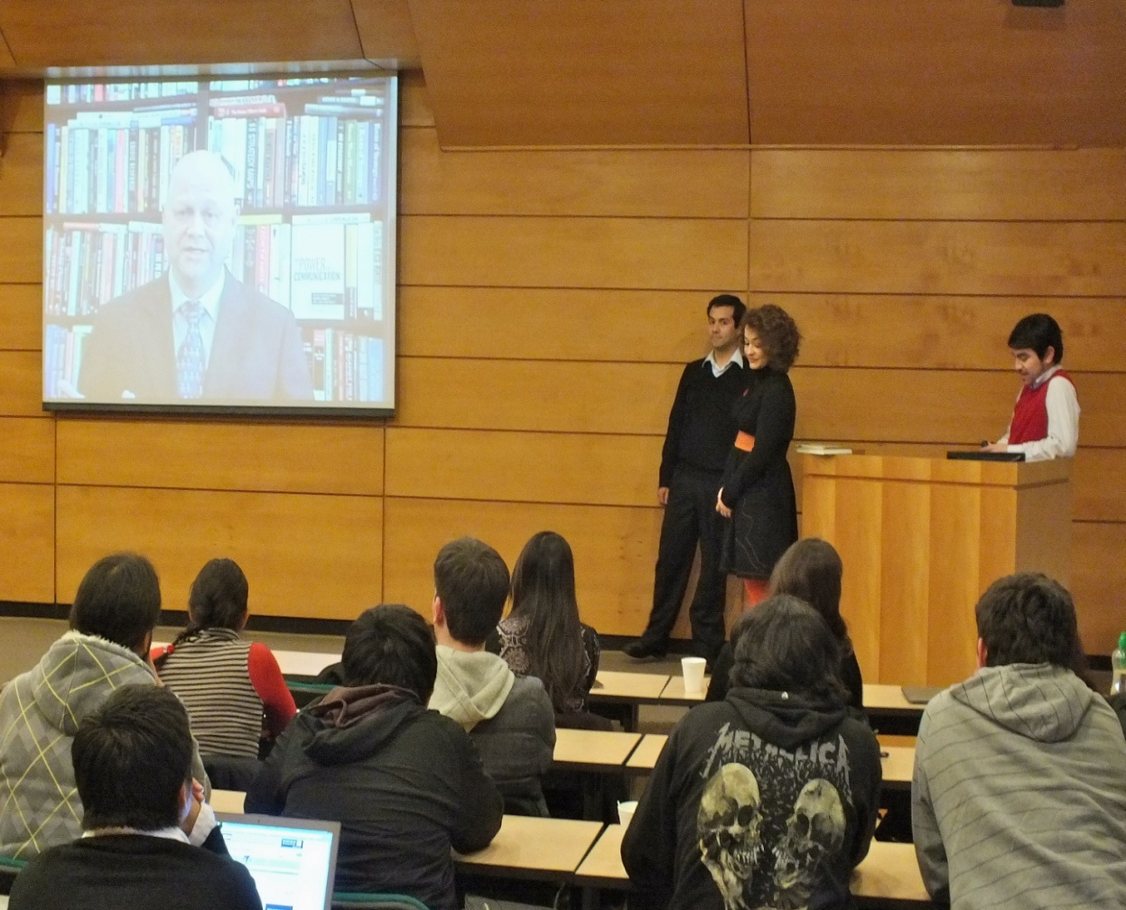
What is Problem-Based Learning?
Challenges students to learn through engagement in a real problem.
Simultaneously develops
  Problem solving strategies
  Disciplinary knowledge bases and skills
Notes:
Problem-based learning (PBL) is an approach that challenges students to learn through engagement in a real problem. It is a format that simultaneously develops both problem solving strategies and disciplinary knowledge bases and skills

Slide 8

Places students in the active role of problem-solvers
Confronted with typical and problem clinical cases that they are likely to face as future speech-language pathologists
Notes:
by placing students in the active role of problem-solvers confronted with real life clinical cases that simulates the kind of problems they are likely to face as future SLPs.

Slide 9
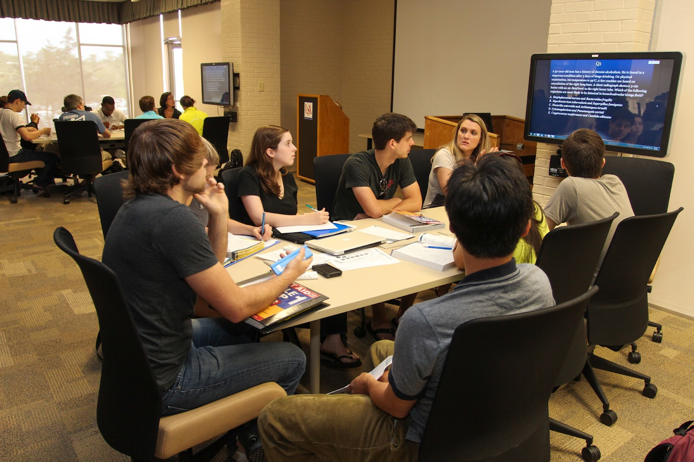
Problem-based learning is student-centered.
Fundamental shift:
  Focus on teaching → to a focus on learning.
  Process aimed at using the power of authentic problem solving to
    Engage students
    Enhance their learning and motivation.
Notes:
Problem-based learning is student-centered. PBL makes a fundamental shift--from a focus on teaching to a focus on learning. The process is aimed at using the power of authentic problem solving to engage students and enhance their learning and motivation.

Slide 10

Unique aspects of PBL
Learning occurs in the contexts of authentic tasks, issues, and problems
Aligned with real-world concerns
Stimulates students to take responsibility for their own learning
  Very few lectures
  No structured sequence of assigned readings, etc.
Notes:
There are several unique aspects that define the PBL approach: The PBL approach is grounded in solid academic research on learning and on the best practices that promote it. This approach stimulates students to take responsibility for their own learning, since there are few lectures, no structured sequence of assigned readings, and so on.

Slide 11

Fosters collaboration among students
Stresses the development of problem solving skills within the context of professional practice
Promotes effective reasoning and self-directed learning
Aimed at increasing motivation for life-long learning.
Notes:
PBL is unique in that it fosters collaboration among students, stresses the development of problem solving skills within the context of professional practice, promotes effective reasoning and self-directed learning, and is aimed at increasing motivation for life-long learning.

Slide 12

Role of the Instructor
Instructor’s role
  Changes from "sage on the stage" → "guide by the side."
  Instructor becomes facilitator and coach of student learning
  Acts at times as a resource person, rather than as knowledge-holder and disseminator.
Notes:
As teacher, my role changes from "sage on stage" to a "guide by the side." My role is more like that of a facilitator and coach of student learning, acting at times as a resource person, rather than as knowledge-holder and disseminator

Slide 13

Role of the Student
More active,
  Engaged as a problem-solver
  Decision-maker
  Meaning-maker
Not a passive listener and note-taker
Notes:
The student role, is more active, as they are engaged as problem-solvers, decision-makesr, and meaning-makers, rather than being merely passive listener and note-taker.

Slide 14

Where did it come from
& who is using it?
PBL originated from a curriculum reform by medical faculty at Case Western Reserve University (Cleveland, OH) in the late 1950s.
McMaster University in Canada further evolved the practice of PBL in their medical school program.
Notes:
PBL originated from a curriculum reform by medical faculty at Case Western Reserve University in the late 1950s. Innovative medical and health science programs continued to evolve the practice of PBL, particularly the specific small group learning and tutorial process that was developed by medical faculty at McMaster University in Canada.

Slide 15

Both institutions considered
Intensive pattern of basic science lectures
Followed by an equally exhausting clinical teaching program
    Ineffective
    Dehumanizing way to prepare future physicians.
Notes:
These innovative and forward-looking medical school programs considered the intensive pattern of basic science lectures followed by an equally exhausting clinical teaching program to be an ineffective and dehumanizing way to prepare future physicians.

Slide 16


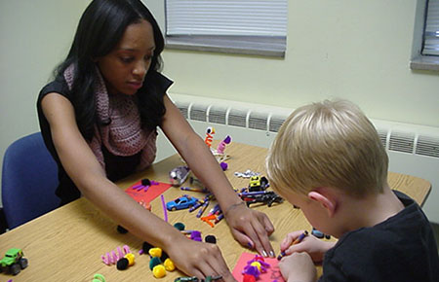

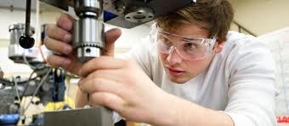
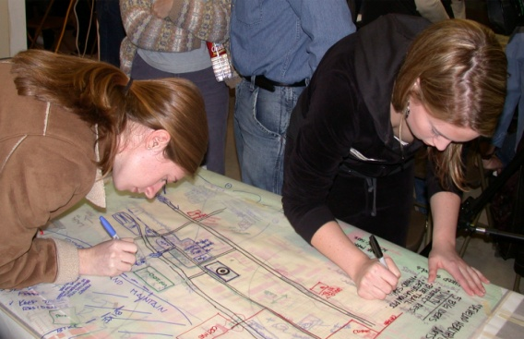
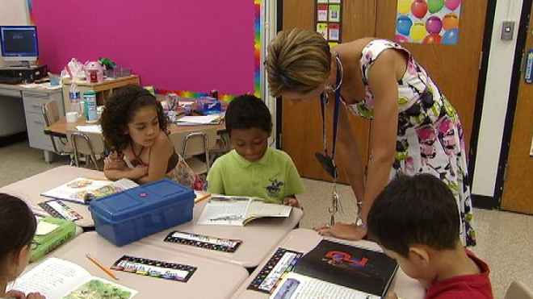
PBL has spread to over 50 medical schools
Diffused into many other professional fields including
  Law
  Economics
  Architecture
  Mechanical and civil engineering
  Speech-Language Pathology
  K-12 curricula
  The entire MBA program at Ohio University has been designed as an integrated curriculum using the PBL approach.
Notes:
Given the explosion of medical information and new technology, as well as the rapidly changing demands of future medical practice, a new mode and strategy of learning was developed that would better prepare students for professional practice. PBL has spread to over 50 medical schools, and has diffused into many other professional fields including law, economics, architecture, mechanical and civil engineering, as well as in K-12 curricula. And the entire MBA program at Ohio University has been designed as an integrated curriculum using the PBL approach.

Slide 17

Why PBL?
Traditional education
  Students disenchanted
  Bored with their education.
Faced with vast amounts of information to memorize
  Much seems irrelevant to the world as it exists outside of school.
Students often forget much of what they learned
  That which they remember cannot often be applied to the problems and tasks they later face in the “real” world.
Traditional classrooms do not prepare students to work with others in collaborative team situations.
Notes:
Traditional education practices, starting from kindergarten through college, tend to produce students who are often disenchanted and bored with their education. They are faced with a vast amount of information to memorize, much of which seems irrelevant to the world as it exists outside of school. Students often forget much of what they learned, and that which they remember cannot often be applied to the problems and tasks they later face in the business world. Traditional classrooms also do not prepare students to work with others in collaborative team situations.

Slide 18

The result:
    Students tend to view education as a "rite of passage,"
    A necessary "union card“
    An imposed set of hurdles with little relevance to the real world.
    Education reduced to acquiring a diploma (merely another commodity to be purchased in the marketplace)
    The final grade becomes the overriding concern (rather than learning).
Notes:
The result: students tend to view education as simply a "rite of passage," a necessary "union card," and an imposed set of hurdles with little relevance to the real world. Education is reduced to acquiring a diploma (merely another commodity to be purchased in the marketplace), and the final grade becomes the overriding concern (rather than learning).

Slide 19
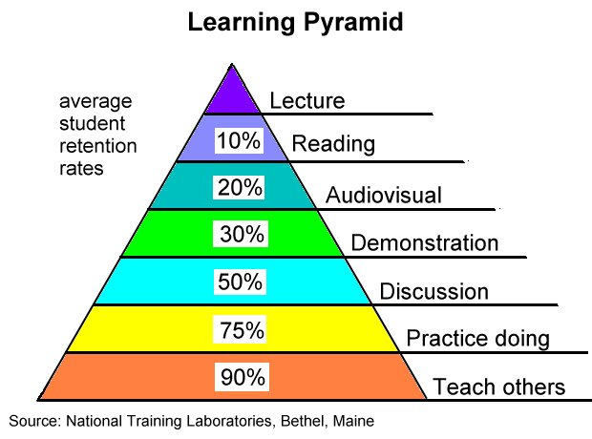
Research in educational psychology has found
  Traditional educational approaches (e.g., lectures) do not lead to a high rate of knowledge retention.
  Most material learned through lectures soon forgotten
  Natural problem solving abilities may actually be impaired.
Notes:
Research in educational psychology has found that traditional educational approaches (e.g., lectures) do not lead to a high rate of knowledge retention. Despite intense efforts on the part of both students and teachers, most material learned through lectures is soon forgotten, and natural problem solving abilities may actually be impaired.

Slide 20

Studies have shown that in 90 days students forget 90% of everything they have been told (Smilovitz, 1996).
Motivation in traditional classroom environments is also usually low.
Notes:
In fact, studies have shown that in 90 days students forget 90% of everything they have been told (Smilovitz, 1996). Motivation in such traditional classroom environments is also usually low.

Slide 21
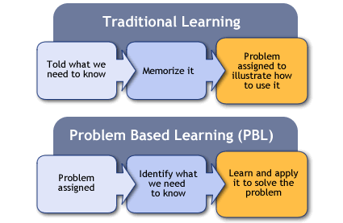
Advantages of PBL
Students enjoy the process of learning
A challenging program
  Intriguing for students because
    They are motivated to learn by a need to understand and solve clinical problems.
The relevance of information learned is readily apparent
  students become aware of a need for knowledge as they work to resolve the problems.
Notes:
Perhaps one of the greatest advantages of PBL is that students genuinely enjoy the process of learning. PBL is a challenging program which makes studying intriguing for students because they are motivated to learn by a need to understand and solve real clinical problems. The relevance of information learned is readily apparent; students become aware of a need for knowledge as they work to resolve the problems.

Slide 22

How it all started in SAHP CMSD
In 1996 Dr. Paige Shaughnessy
  Met Directors of a PBL speech pathology program from Hong Kong
Skepticism and curiosity
  Lead to Paige traveling to Hong Kong for 3 days to observe the program
When she returned to the U.S., she was a “PBL believer”.
Notes:
In 1996, Dr. Paige Shaughnessy met Program Directors of a Speech-language pathology graduate program in Hong Kong who had designed the entire program in PBL format
Skepticism and curiosity lead to Paige traveling to Hong Kong for 3 days to observe the program
When she returned to the U.S., she was a “PBL believer”.

Slide 23

In 1997, Paige began teaching every graduate course in her workload in PBL format (she taught a track of 3 courses on adult neurogenics).
  At the time, she was the only faculty member in the department doing this
Notes:
In 1997, Paige began teaching every graduate course in her workload in PBL format (she taught a track of 3 courses on adult neurogenics).
At the time, she was the only faculty member in the department doing this

Slide 24




Karen Mainess in 2008 (Childhood Language Disorders course sequence)
Terry Douglas in 2009 (Fluency disorders)
Jennifer St Clair in 2012 (Speech Sound Disorders)
Christina Bratlund 2012 (Voice and Swallowing Disorders)
Currently, all but 4 courses in the graduate program are taught in the PBL format
Notes:
Karen Mainess became interested in using the format in 2008 (Childhood Language Disorders course sequence)
Followed by Terry Douglas in 2009 (Fluency disorders)
Jennifer St Clair in 2012 (Speech Sound Disorders)
Christina Bratlund 2012 (Voice and Swallowing Disorders)

Slide 25

The Syllabus
Group Meetings/Research
Students are divided into small groups (usually 6 per group),
Address problems related to course subject (e.g., adult neurogenic communication disorders).
Groups are assigned at the beginning of the academic quarter
Notes:
Group Meetings/Research
Students are divided into small groups (usually 6 per group), in which they address problems related to adult neurogenic communication disorders. Groups are assigned at the beginning of the academic quarter, with a Facilitator for each group. Groups meet weekly, according to the class schedule. Students are expect to spend a significant amount of additional time each week researching learning issues.

Slide 26

A Facilitator is assigned to each group.
Groups meet weekly, according to the class schedule.
Students are expected to spend a significant amount of additional time each week researching learning issues.
Notes:
A Facilitator is assigned to each group.
Groups meet weekly, according to the class schedule.
Students are expected to spend a significant amount of additional time each week researching learning issues.

Slide 27
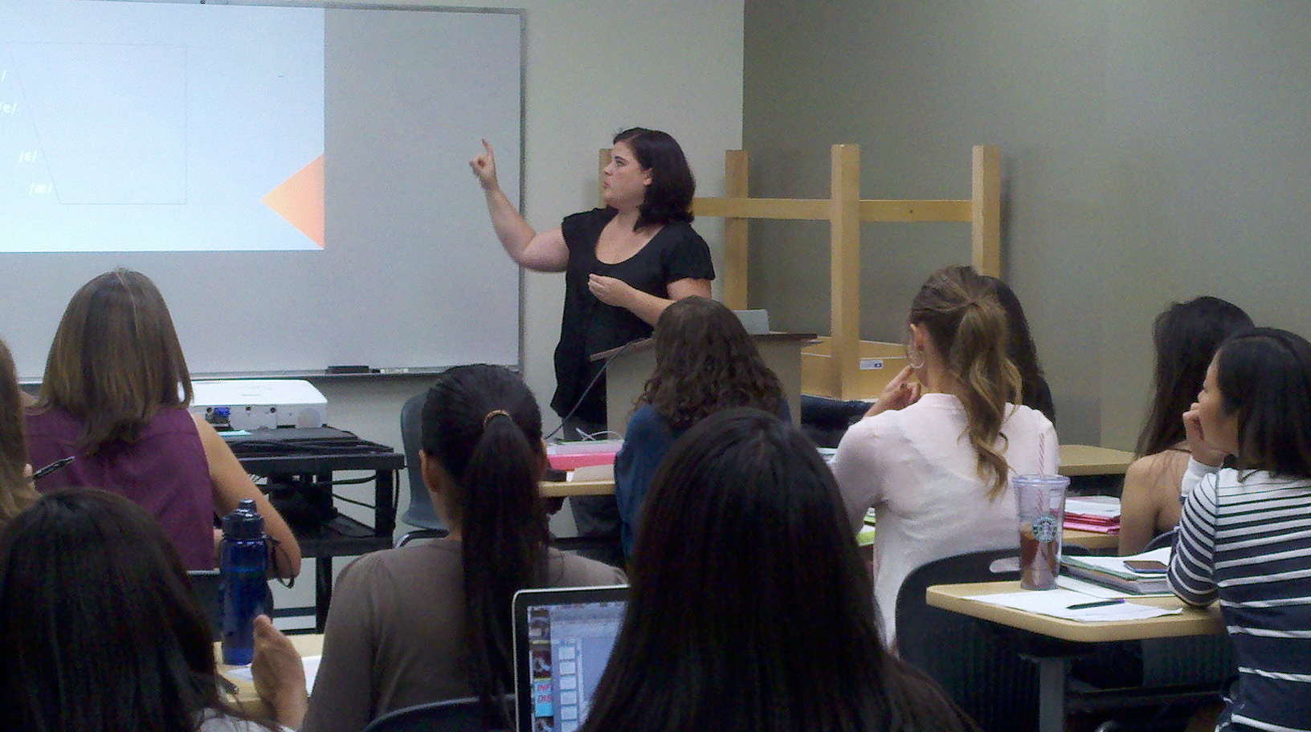
Week One
Analysis Phase
Instructor presents a written description or shows a video of the problem (case).
Using a Case Worksheet:
Plenary Group: Students work together to describe communication skills through observations;
Networking Group: Students work in small groups to list the knowledge or skills (learning issues) needed to address the problem and to make research assignments on particular learning issues.
Notes:
Week One: Analysis Phase — Instructor presents a written description or shows a video of the problem (case).
Using the Case Worksheet:
(a) Students work together (Plenary Group) to describe communication skills through observations;
(b) Students work in small groups (Networking Group) to list the knowledge or skills (learning issues) needed to address the problem and to make research assignments on particular learning issues.

Slide 28

Prior to Week Two
Research Phase
Students conduct independent research in preparation for the next week’s meeting.
By the end of the quarter, students are expected to have covered all of the learning outcomes for the course.
Students prepare a handout of their research, which is posted on Canvas in preparation for the next class.
Notes:
Research Phase
Students conduct independent research in preparation for the next week’s meeting. By the end of the quarter, students are expected to have covered all of the learning outcomes for the course.
Students prepare a handout of their research, which is posted on Canvas in preparation for the next class.

Slide 29
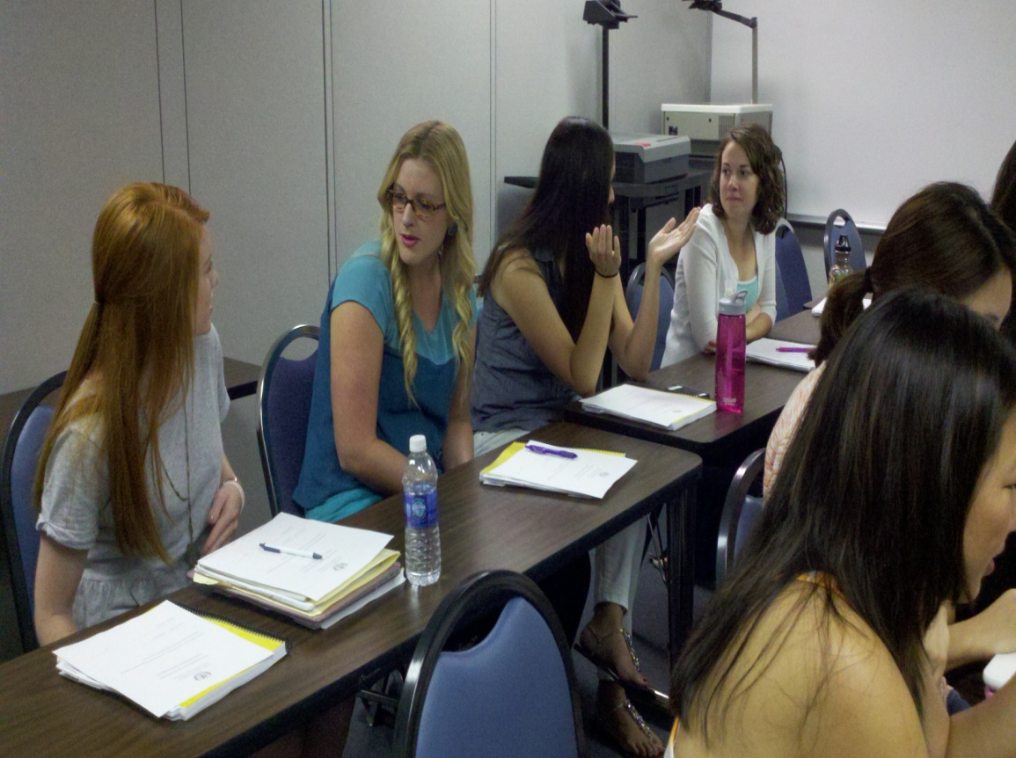
Week Two
Synthesis and Evaluation Phase
Students report their findings and discuss learning issues that were researched – Networking Groups.
Students work together to summarize what they learned and to list issues that still need to be addressed – Networking Groups.
Notes:
Synthesis and Evaluation Phase
Students report their findings and discuss learning issues that were researched – Networking Groups.
Students work together to summarize what they learned and to list issues that still need to be addressed – Networking Groups.

Slide 30
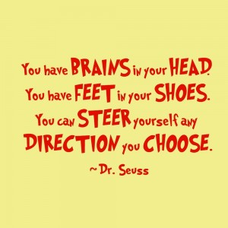
Independent Learning Activities (ILAs)
In addition to the weekly group meetings, students are expected to pursue competency in specified related skills by completing independent learning activities (ILAs).
  Requirements for each ILA are explained in a separate handout.
In general, one (1) ILA must be completed each week
  Because there are 7-8 ILAs in a quarter, there will be some weeks when an ILA is not due
  Students post their ILAs to CANVAS.
Notes:
In addition to the weekly group meetings, students are expected to pursue competency in specified related skills by completing independent learning activities (ILAs). Requirements for each ILA are explained in a separate handout.,
In general, one (1) ILA must be completed each week
Because there are 7-8 ILAs in a quarter, there will be some weeks when an ILA is not due
Students post their ILAs to CANVAS.

Slide 31

Role of the Instructor
The Instructor presents the problem (case) and guides students through the observations.
The Instructor also guides the Facilitators
Makes resources available to students
Evaluates students’
  ILAs
  Handouts
  final exam
  Assigns final grade.
Notes:
Role of the Instructor – The role of the Instructor is to present the problem (case) and to guide students through the observations. The Instructor also guides the Facilitators, makes resources available to students, evaluates students’ ILAs, handouts, and final exam, and gives the final grade.

Slide 32

Role of the Facilitator
Fosters critical thinking
Guides students in the direction they wish to pursue, as long as all learner outcomes are addressed.
Provides general assistance in locating resources and interpreting original works.
Notes:
The role of the Facilitator is to foster critical thinking, and to guide students in the direction they wish to pursue, as long as all learner outcomes are addressed. The Facilitator also provides general assistance in locating resources and interpreting original works.

Slide 33

Role of the Students
Develop skill in observing and characterizing
patterns of communication breakdown
Work collaboratively to analyze cases and identify
issues that need to be addressed
Research the issues
Engage in the process of discovery
Lead and participate in small group discussions that
arrive at integration and application of the knowledge to
the client or patient population
Notes:
Develop skill in observing and characterizing
patterns of communication breakdown
Work collaboratively to analyze cases and identify
issues that need to be addressed
Research the issues
Engage in the process of discovery
Lead and participate in small group discussions that
arrive at integration and application of the knowledge to
the client or patient population

Slide 34
General Approaches to Implementing PBL into the Curriculum
Completely integrated PBL curriculum
Transitional approach - basic/foundation courses are in lecture format; higher level courses use PBL
Single-course approach – independently decided by course instructor
Notes:
In the Department of Communication Sciences and Disorders at Loma Linda University, PBL was first implemented in 1999 with a class of first-year graduate students in a seminar on traumatic brain injury. There were 15 students in the class, and they were divided into to two groups. Each group was assigned a facilitator (the instructor and a volunteer faculty member). In this three-unit course, the groups met once each week for 10 weeks (one quarter). They were given problems, which were video-taped cases. The students were required to identify learning issues, make individual assignments for research, and report to their respective groups the following week. Group configurations remained consistent through the quarter. The following year, two other courses, which were taught by the same instructor, adopted the PBL format.
2000– Paige started PBL in her 3 graduate courses
15 students – 2 groups – This was easy.
First year – students hated it; but, the thing that kept her going was when one student said, “Finally, someone understands how I learn.”
second year, it was a little better; by the 3rd year, it was a part of the culture (dreaded, but expected)
↑’d to 18 students – 2 groups of 9 on the same day or 3 groups of 6 on two different days – Not so easy
Karen joined –2 courses (two days) of 2 groups of 9 on the same day or 3 groups of 6 on two different days – Not at all easy
2011 –
25 students – 2 groups – Not small enough
Karen & Terry joined
Jennifer asked for mentoring
2012 –
30 students – need to have smaller groups without increasing in-class time for instructor
Christina hired
Paige mentoring Brian, Karen, Terry, Jennifer, Christina
We had to change the way we did this without giving up the focus that had worked for 12 years.

Slide 35


The Vision
6/7 faculty are convinced of the benefits of learner-
centered teaching & want to use it; the other one just
doesn’t know it yet.
The Challenge
Groups of 6 – 8 students work best
30 students – too big for the old approach
Limited faculty to facilitate more groups
Notes:
Events (increased enrollment) and trends (faculty embrace learner-center instruction, especially PBL) often do more to shape innovation than isolated creative moments. The faculty, having been convinced of the value of PBL, created a vision of all the graduate courses that, while continuing to be distinct, would adopt a common framework. The first challenge was to guarantee the essential ingredient of small groups, given a class size of 30. Another challenge was to assure that the instructor’s awareness of each student’s knowledge would be maintained.

Slide 36

The Plan
Stages
1. Invite recent graduates (because they would be more familiar
with the format than untrained contract faculty) to be facilitators
2. Development and implement orientation and mentoring
3. Pay them
4. Ensure consistency across courses by developing and
implementing a structured format
5. Assess the plan at mid-term and at end-of-quarter
Notes:
The first four stages of the plan were designed to meet the challenges of class size and limited faculty. The last stage – Stage 5 –was designed to assess the feasibility of the whole process.
In Stage One, recent graduates of the program (who had gone through the PBL process as students) were invited to be facilitators. This was the most innovative aspect of the program. Initially, select alumni were invited, but, as word spread, more and wanted to be included. Since all graduate courses are held in the late afternoon or evenings, facilitators were able to come after work. Some facilitators volunteered for more than one course, meaning that they were back on campus two nights a week for ten weeks. All except one of the facilitators who started in autumn quarter continued through the year (winter and spring).
In Stage Two, the facilitators were trained, and a mentoring program was implemented.
Stage Three was to develop a reward system for the facilitators. The Department was able to pay them a small stipend; however, the facilitators stated they would have done this for no pay.
Stage four – next slide.

Slide 37
Consistency Across Courses
(Structure & Process)
Syllabus – Explains the Process
  Two-week cycles
  Roles
Groups
Format Guides
Assessment of Students
Notes:
Stage Four included the development and implementation of a consistent structure and format for all instructors, facilitators, and students to follow. Procedures for introduction of cases and learning issues and for the specific functions of different styles of groups were detailed.
While rigid adherence was not demanded, most instructors and facilitators appreciated the structure.
Initially, the procedures provided a framework that was consistent across all courses. Eventually, while the framework was retained, instructors and facilitators incorporated their individual touch, in harmony with their own comfort level.
Details of the format, course syllabi, and facilitator and session guides follow.

Slide 38

Assessment of Students
Standard of Excellence-Group Discussion Participation Rubric
Standard of Excellence-Weekly Handouts Rubric
Independent Learning Activities (ILA)
  Rubric Specific to each ILA
4. Final Examination

Slide 39

Participation in Group Discussion
Group participation
  Fundamental to format and learning environment.
Students expected to lead group in discussion of the issues.
Standard of Excellence-Group Discussion Participation Rubric
  Used by facilitator to evaluate and assign participation grades for each student in the group.
Notes:
Group participation is fundamental to the format and learning environment of this class.
Students prepare to lead the group in discussion of the issues.
The Facilitator uses the Standard of Excellence-Group Discussion Participation Rubric to evaluate and assign participation grades for each student in the group.

Slide 40
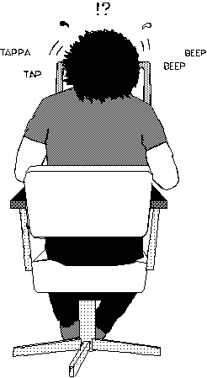
Handouts/Individual Contributions
Students prepare a written summary of their learning issue (outline).
A handout of essential information is
  Posted on CANVAS for the Instructor
  Emailed or Dropboxed to the 6 members of their group one day prior to the next meeting date.
Standard of Excellence-Weekly Handouts Rubric
  Used by the instructor to grade handouts
Notes:
Handouts/Individual Contribution
Students present their research on individual learning issues in two ways: (1) group discussion; and, (2) written summary of the learning issue (handout). Students prepare a handout of essential information, which is posted on Canvas for the Instructor and emailed to the 6 members of their group. Handouts must be posted and emailed by 6:00 PM on Tuesdays (note dates on the master calendar).
Handouts are graded by the Instructor, using the Standard of Excellence-Weekly Handouts Rubric. Scores for all handouts are averaged at the end of the quarter and count 30% of the final grade.

Slide 41

Independent Learning Activities (ILAs)
Each ILA has different requirements
  E.g., Administer a (given) test and interpret the results
    Instructor uses a rubric specific to that ILA to grade the student’s submission (uploaded to CANVAS)
  E.g., Analyze a language sample (using a specific method as learned independently)
    Instructor uses a specific rubric to grade this ILA

Slide 42

Final Examination (Options)
CMSD 684 – Sem: Adult Language Disorders
The week before final exam week, a video is uploaded onto CANVAS for the students to view (as many times as they wish).
  Students required to answer (in writing) specific questions regarding
    Clinical observations and impressions
    Diagnosis hypothesis and rationale
    Choice of diagnostic tools and rationale for use
    Choice of treatment approaches and rationales
    Citations and references
  Students have one week to complete the exam.
    Papers must be typed, double-spaced, and uploaded to CANVAS
A letter grade is assigned based on the criteria outlined in the CMSD 684 Examination Rubric
Notes:
Written Examination
The week before final exam week, students are given a DVD of the examination problem.
Students answer specific questions related to the case, and then choose one issue to research.
They have one week to complete the exam. There is no minimum number of references; however, students are expected to thoroughly cover the selected issue. Papers must be typed, double-spaced, and uploaded to CANVAS

Slide 43

Or . . .
CMSD 525 & 682
Final Examination - Oral Presentation/
In-service.
Students are required to integrate information learned in two PBL courses offered during the same academic quarter
Assigned to work in groups of three to develop one 20 minute presentation, designed to be an in-service for selected target audiences (e.g., Parents of children with TBI).
  Must integrate what they know about child language disorders and traumatic brain injury in order to design the in-service
Students are randomly assigned to topic and target audience.
The in-services are presented on the day of the final examination
Notes:
Final Examination - Oral Presentation/In-service.
Students are assigned in groups of three to develop one 20 minute presentation, designed to be an in-service for one of the target audiences listed below. Students are randomly assigned to topic and target audience. The in-services are presented on the day of the final examination (Monday, June 10th from 9:00am to 12:00pm and Tuesday, June 11th from 9:00am to 12:00pm).
In-services should include PowerPoint (PP) presentations, pamphlets, posters, activities for audience participation, etc. A transcript of the in-service must be provided to both instructors on the day of the presentation. A handout of the PP presentation must be prepared for the instructors and the other members of the class. No photocopies of textbook pages (except pictures) or downloaded web pages will be accepted. ALL reference materials must be cited, and should be listed as a separate page or slide. Students are encouraged to structure opportunities for the audience to participate.
A letter grade is assigned based on the criteria outline in the “Standard of Excellence-Oral Presentation.” Both instructors will confer to assign a letter grade that will count for each class. The In-service “package” counts as 30% of the final grade.

Slide 44

In-services are required to include
  PowerPoint (PP) presentations
  Pamphlets
  Posters
  Activities for audience participation, etc.
  A transcript of the in-service (for the instructors)
  A handout of the ppt presentation (for peers & instructors)
  References and citations
A letter grade is assigned based on the criteria outline in the “Standard of Excellence-Oral Presentation.”
Both instructors confer to assign a letter grade that will count for each class.

Slide 45

Assessment of the Process
Students
  Email survey/students (how is it going?)
    Recorder form – more room
    Case Worksheet revised
Facilitators
  Orientation
  Quarterly feedback sessions
  Email survey/students (how is it going?)
Notes:
Stage Five involved assessment of Stages One through Four, from the point of view of all the stakeholders, including assessment of the process, as well as assessment of student knowledge. The results of assessment will be shared during this presentation.

Slide 46
Feedback from Students & Alumni
How is the PBL process going?
Overall, the process is going well. I feel the structure is beneficial on many different levels. We are not only learning the content/material but also acquiring the skills of problem-solving, deep critical thinking and synthesizing. It is excellent training for post-graduate school and, while we still may be mapping out the territory and navigating somewhat blind, I'm happy to be learning this skill set now.

Slide 47
I feel like I'm beginning to understand it better. I will remember the topics that I had to research. It was a rough concept to grasp at first, but I'm starting to like it.
The process seems to be going well. It has its positive and negative aspects, but overall I think it is a good process. In regards to the positives, it requires us to learn how to research information related to a learning issue. This is a crucial skill that we will need for the field so I appreciate its necessity. I also feel that I have learned a lot in regards to the topics that I have researched, which is a great feeling. It also encourages discussions among our small groups, which has been very constructive.

Slide 48
Less Glowing Remarks
I am starting to adjust to the format but I still feel lost as far as what exactly I should be learning and if our group covered all the things we should have. It would be helpful if you discussed some of the major topics we need to be learning in the second week. It would also be helpful to watch a portion of the videos during the second week or if you could post them on canvas.

Slide 49
I think it is going OK, but it has taken a lot of getting used to. I feel a little bit confused about where I am, or how much I should be knowing. I feel like I need some reading assignments, related to the book to make sure that I am covering all of the information, or someone to confirm if what I am learning is at par with KASA. It would also be helpful to have some wrap-up to each of the cases, or a diagnosis for the person on video, since it might help to point me in other directions or other topics that would interest me.

Slide 50
What is your major concern/fear?
One concern I have is whether or not I am building the foundation I need for myself, in terms of content. I understand that the important concepts/goals of PBL is not the acquisition of the content per se, but all the previously stated skills as well; however, practically speaking, we still need to know facts/have a solid content base in order to ask meaningful questions and go deeper in our critical thinking. To that, I feel some of the facilitators are not doing their job properly. One, however, does an excellent job in asking us questions, semi-guiding/directing us onto relevant paths, helping us see the larger picture and selecting relevant topics. I appreciate that this facilitator does more than just observe us.

Slide 51
My major concern is that I am not learning everything I need to know. In this format I feel that I am only learning the one topic that I choose to research for that week and am missing other information that I need to know.
That we won't have time to cover everything.

Slide 52


Slide 53
Contact Us
Christina Bratlund – cbratlund@llu.edu
Terry D. Douglas – tddouglas@llu.edu
Karen Mainess – kmainess@llu.edu
Jennifer St. Clair – jstclair@llu.edu

Slide 54
References
Albanese, M. A., & Mitchell, S. (1993). Problem-based learning: A review of the literature on its outcome and implementation issues. Academic Medicine, 68, 52-81.
Barrows, H. S., & Tamblyn, R. N. (1980). Problem-based learning: An approach to medical education. New York: Springer.
Collins, A., Brown, J.S., & Newman, S.E. (1989). Cognitive apprenticeship: Teaching the crafts of reading, writing, and mathematics. In L. B. Resnick (Ed.) Knowing, learning, and instruction: Essays in honor of Robert Glaser (pp. 453-494). Hillsdale, NJ: Lawrence Erlbaum Associates.
Duch, B.J., Groh, S.E., & Allen, D.E. (Eds.) (2001). The power of problem based learning. Sterling, VA: Stylus.
Fallik, O., Eylon, B., & Rosenfeld, S. (2008, October 23). Motivating teachers to enact free-choice project-based learning in science and technology (PBLSAT): Effects of a professional development model. Journal of Science Teacher Education, 19, 565-591.
Golden, D. (2006, November 13). Colleges’ accreditors seek better ways to measure learning. The Wall Street Journal Online, Retrieved May 16, 2007, from http://onlin.wsj.com/article_pring?SB116338508743121260.html.

Slide 55
Saarinen-Rahiika, H., & Binkley, J. M. (1998). Problem-based learning in physical therapy: a review of the literature and overview of the McMaster University experience. Physical Therapy, 78, 195-207.
Scardamalia, M., & Bereiter, C. (1991). Higher levels of agency for children in knowledge building: A challenge for the design of new knowledge media. Journal of the Learning Sciences, 1(1), 37–68.
Smilovitz, R. (1996). If not now when?: Education not schooling. Kearney, NE: Morris Publishing.
Stokes, S. F., MacKinnon, M. M., & Whitehill, T. L. (1997). Students’ experiences of PBL: journal and questionnaire analysis. Australian Journal of Higher Education, 27, 161-179.
Wendover, R.W. (2008). The demise of reflection. Retrieved September 20, 2008, from http://www.gentrends.com/the_demise_of_reflection.html.

Slide 56
Young, N. A. (1998). Problem-based learning: using cases to drive the learning process. Journal of Dental Education, 62, 235-241.
Zemke, R., Raines, C., & Filipczak, B. (2000). Generations at work. New York: AMACOM.

