Slide 1
The 2nd Annual LLUSD-LLUSP Interprofessional Clinical Case Discussion Session on May 15, 2017

Slide 2
Activities and Goals
A single session of interprofessional clinical case discussion
Spring quarter
Dentistry and pharmacy students collaborate and discuss therapeutic cases
Encourage students to work as a team, communicate with respect, and utilize each other’s knowledge to provide an optimal and safe patient care

Slide 3
Class Information
 | DENTISTRY | PHARMACY
CLASS | 2019 (D2) | 2019 (P2)
NUMBER OF STUDENTS | 98 | 69
COURSES | PHRM-501 PHARMACOLOGY AND THERAPEUTICS | RXTH-685 IPDM V- CARDIOVASCULAR II
NUMBER OF UNITS | 4.0 | 3.5
SESSION’S PERCENTAGE POINTS IN THE TOTAL COURSE GRADE | 5% | 3%

Slide 4
Session Information
Location: Wong Kerlee Conference Room
A total of 167 students
24 tables with 7-8 dental and pharmacy students
6 clinical cases with 24 questions
Each table answered one question
Dental students in blue scrubs and pharmacy students in white coats
15 minutes to review and discuss cases and 45 minutes for answering questions and for faculty to provide comments on cases

Slide 5
Survey and Evaluation
119 students completed pre- and post-surveys regarding interprofessional education, training, and practice
Each group was evaluated by the attending faculty on their communication skills and team work

Slide 6
Survey Questions (Modified Version of RIPLS)
Learning with other students/professions will help me become a more effective member of a health care team.⬆
Patients would ultimately benefit if health care students/professionals worked together to solve patient problems.
Shared learning with other health care students will increase my ability to understand clinical problems.⬆
Learning with health care students from other disciplines before clinical practice would improve relationships during clinical practice.⬆
Communication skills should be learned with other health care students.
Shared learning will help me to think positively about other professionals.⬆
For small group learning to work, students/ professionals need to trust and respect each other.⬆
Team-working skills are essential for all health care students to learn.
Shared learning with other health-care students will help me to understand my own limitations.⬆
I do not want to waste my time learning with other health care students.⬇
It is NOT necessary for health care students to learn together.⬇
Clinical problem-solving skills should only be learned with students from my own discipline.⬇
Shared learning with other health care students will help me to communicate better with patients and with other professionals.
I would welcome the opportunity to work on small group projects with other health care students.⬆
Shared learning with other health-care students will help to clarify the nature of patient problems.⬆
Shared learning before clinical practice would help me become a better team worker.⬆
The function of pharmacists is mainly to dispense medication.⬇
The function of dentists is mainly to restore teeth.⬇
I am not sure how dentists and pharmacists can collaborate in patient care.⬇
I have to acquire much more knowledge and skills than other health care students.⬇
I am comfortable consulting with a dentist or pharmacist regarding patients' oral, pharmaceutical and general health concerns.⬆

Slide 13
Acknowledgements
The 2017 session was sponsored by the School of Dentistry
Attending faculty:
Drs. Kathleen Besinque (LLUSP), Euni Cho (LLUSD), Paul Gavaza (LLUSP), Robert Handysides (LLUSD), Alireza Hayatshahi (LLUSP), Lisa Hong (LLUSP), Maryam Molki (PGY-1, LLUSP), Rashid Mosavin (LLUSP), Erin Richards (LLUSD), Javad Tafreshi (LLUSP), Farnoosh Zough (LLUSP)
Supporting staff:
Ms. Jennifer Mathew, Event Coordinator (LLUSP)
Ms. Nicole Pyo (LLUSP)
Ms. Ashley Vasquez (LLUSD)

Slide 14
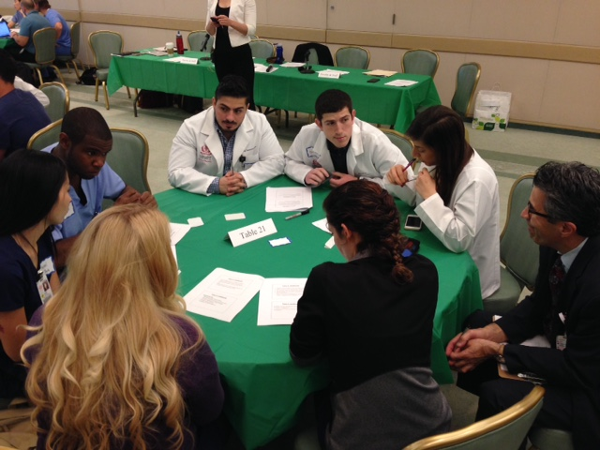

Slide 15
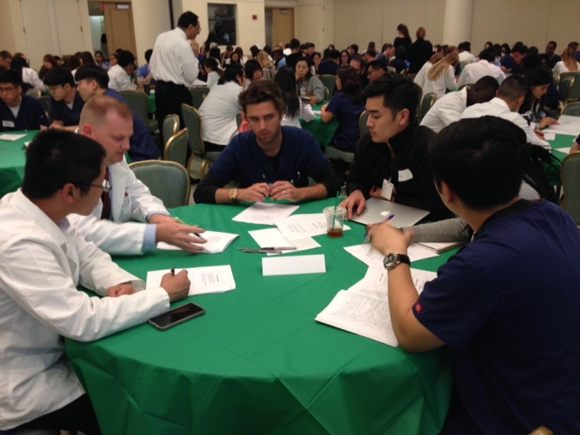

Slide 16
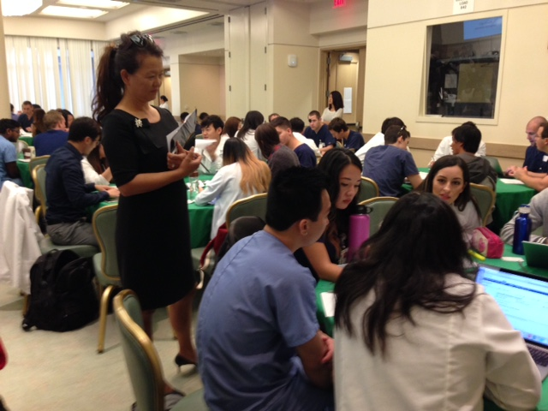

Slide 17
