Slide 1
Can I Get A Little Help Here?
Using Formative Dialogues to Improve Teaching

Slide 2
Is Feedback Important?

Slide 3
Course Objectives
Describe the difference between
summative evaluation and formative dialogues
Observe a faculty member teaching and
take notes for dialogue
Prepare for and discuss teaching observations
Describe optimum feedback experience
Prepare to certify as a Colleague in the
Formative Dialogues program

Slide 4
Your Experience (Think Pair Share)
What is your feedback experience?
How would you describe good feedback?
How would you describe poor feedback?

Slide 5
Is There a Better Way?

Slide 6
Typical summative teaching observation

Slide 7
Formative Dialogues
Are
Are Not
Confidential
Collegial
Requested
Supportive
Safe
Public
Punishment
Punitive
Forced
Summative

Slide 8
Formative Dialogues...
"the formative review of teaching is more of a partnership between colleagues where a supportive, non-judgmental conversation can occur in a collaborative and reflective environment."
"Formative Dialogues in Teaching (FD)…, provides a formalized approach to peer coaching, allowing faculty members the voluntary opportunity to request to have a supportive colleague observe them in a teaching role and discuss their observations."
Rice, G., J. Chiropr Educ. 2012 Spring; 26(1): 62–67.

Slide 9
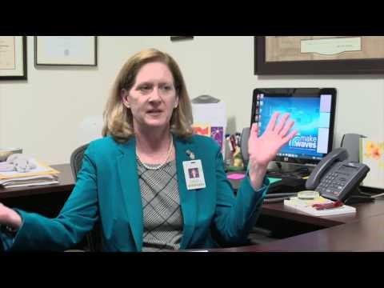
Formative Dialogue

Slide 10
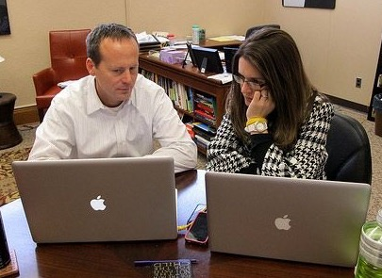
The Process
Pre-Meeting
Observation
Dialogue (Debrief)
Reflection

Slide 11
Observation of Teaching
PreMeeting – We are asked to focus on:
Does she talk too fast
How is her use of visuals
Does she have distracting mannerisms
How are her questioning techniques
Are students engaged

Slide 12
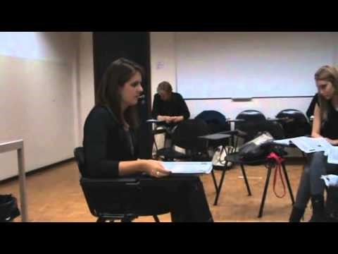
Observation of Teaching

Slide 13
A few days after the teaching session, you both meet for the teaching session debrief

Slide 14
Partner Up

Slide 15
Shortest hair – teacher Longest hair - colleague

Slide 16
How did it go?

Slide 17
Challenge

